Slide 1
Meeting Week 23
Last week summary
  Augmentation improved
  Real data verification → drift off
Outline ToDo next week

Slide 2
Initial problem
After initialization immediate blow up → factor 100 worse
Issue stiffness matrix K only positions for Theta (X, Theta, Y)
K = [0, 0, 0;
0, kb1+kb2, 0;
0, 0, 0]
Resulted in ANN correction accumulating over my simulation steps without demping

Slide 3
Previously I solved this with a trainable C matrix for augmentation (C_aug) for the output
  Didn’t blow up, but states also didn’t learn anything
Asked Jan for advice
  → Only augment states with a spring → Theta

Slide 4
Results
=== Test-set sim-NRMS + RMS - generalization to unseen excitation ===
augmented baseline FP improve
(NRMS RMS [m]) (NRMS RMS [m])
X1: 0.0023 1.376e-04 m 0.0047 2.816e-04 m +51.1%
X2: 0.0018 1.162e-04 m 0.0044 2.803e-04 m +58.5%
Y : 0.0023 5.225e-04 m 0.0080 1.853e-03 m +71.8%

Slide 5
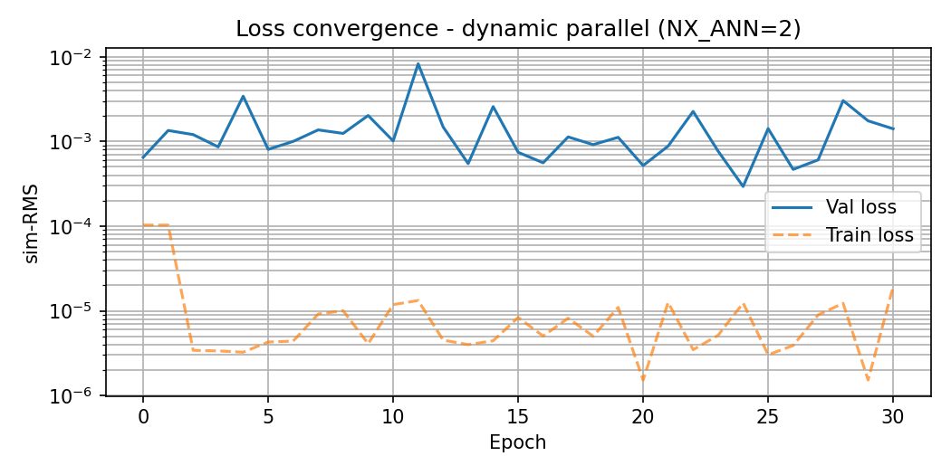

Slide 6
=== Sim-NRMS + RMS: augmented vs baseline FP ===
augmented baseline FP improve
(NRMS RMS [m]) (NRMS RMS [m])
X1: 0.0036 2.114e-04 m 0.0034 2.050e-04 m -3.1%
X2: 0.0036 2.325e-04 m 0.0031 2.005e-04 m -15.9%
Y : 0.0017 3.999e-04 m 0.0037 8.492e-04 m +52.9%
Initial Validation sim-RMS= 0.0006494843
Training complete. Best validation sim-RMS: 0.000294

Slide 7
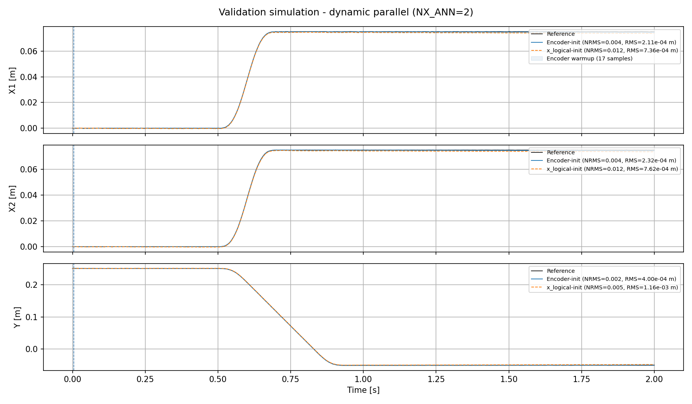
Notes:
Run:= 68676

Slide 8
X_logical init was only for reference
Used the true initial states instead of the encoder for initialization
Notes:
Run:= 68676

Slide 9
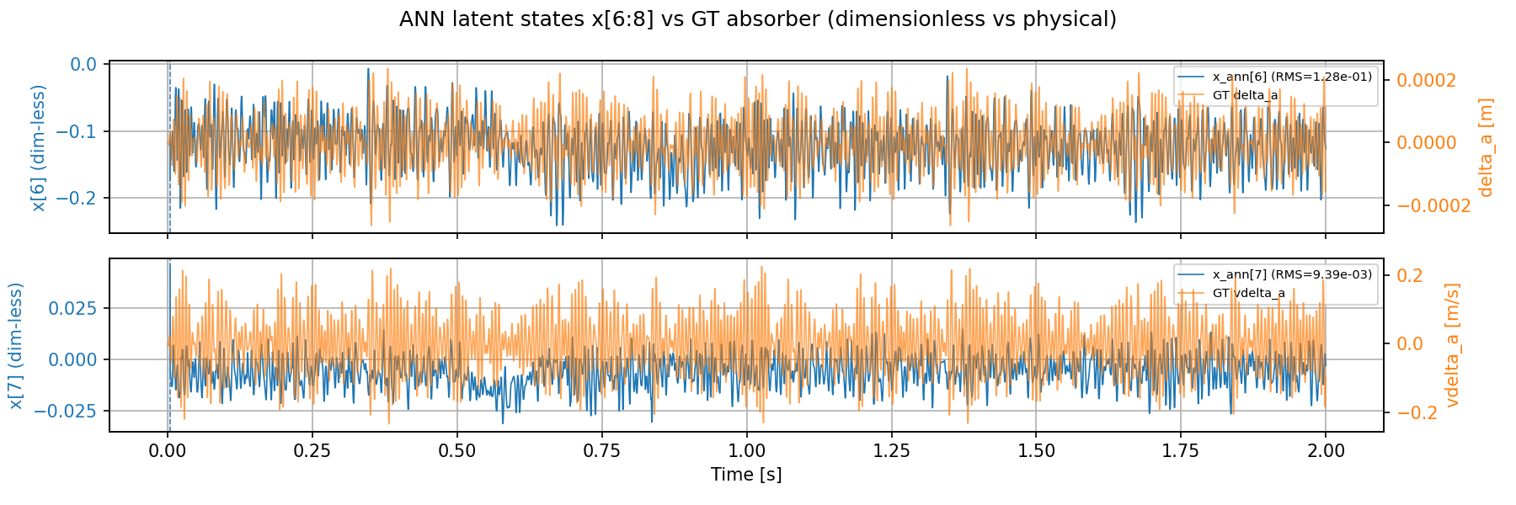
Are the states identifiable?

Slide 10
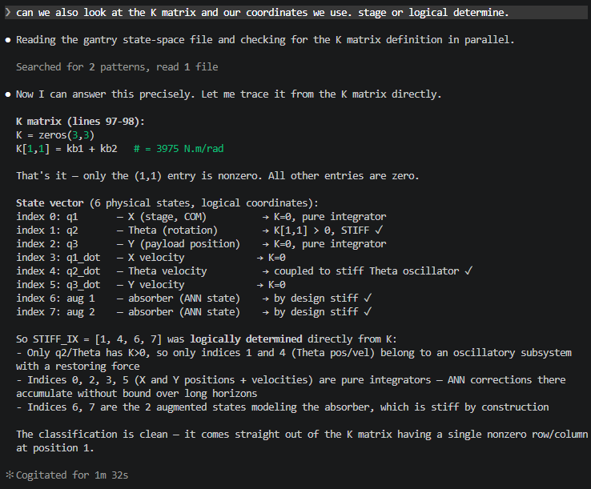
Stiffness only

Slide 11
Previous issue states didn’t learn
K matrix only for Theta rows
Immediate blow up
  I solved this with alternative routing by C_aug. states didn’t learn anything

Slide 12
What to do about y-routing…

Slide 13
When good enough?
→ Reach noisefloor
Advice from Jan add noise and if you reach the noise floor good enough
Notes:
Use the baseline model error to determine the noise

Slide 14
Joint estimation
Implemented
Currently have only run it for a couple parameters
  All parameters still currently running

Slide 15
Joint estimation
Implemented
Currently have only run it for a couple parameters
  All parameters still currently running
Parameters were identifiable, but error got worse than baseline model

Slide 16
=== Joint estimation: physical parameters (best checkpoint) ===
param init learned delta
kb_sum 4372.5000 4102.0200 -6.19%
cg1 15.9500 15.9632 +0.08%
cg2 18.2700 18.2941 +0.13%
cy 11.0000 10.9747 -0.23%
cb_sum 16.2000 16.0853 -0.71%
=== Sim-NRMS + RMS: augmented vs baseline FP ===
augmented baseline FP improve
(NRMS RMS [m]) (NRMS RMS [m])
X1: 0.1073 6.386e-03 m 0.0034 2.050e-04 m -3014.7%
X2: 0.0991 6.347e-03 m 0.0031 2.005e-04 m -3065.4%
Y : 0.0139 3.196e-03 m 0.0037 8.492e-04 m -276.4%
Initial Validation sim-RMS= 0.0058515198
Best validation sim-RMS: 0.005516

Slide 17
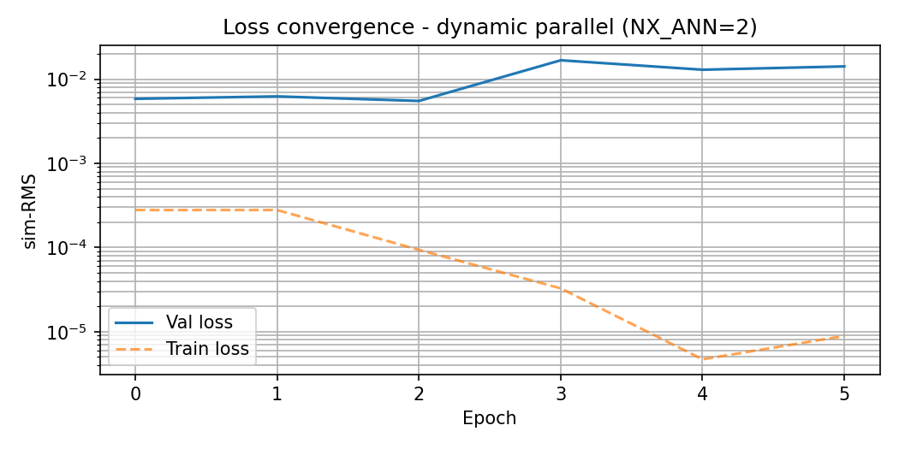

Slide 18
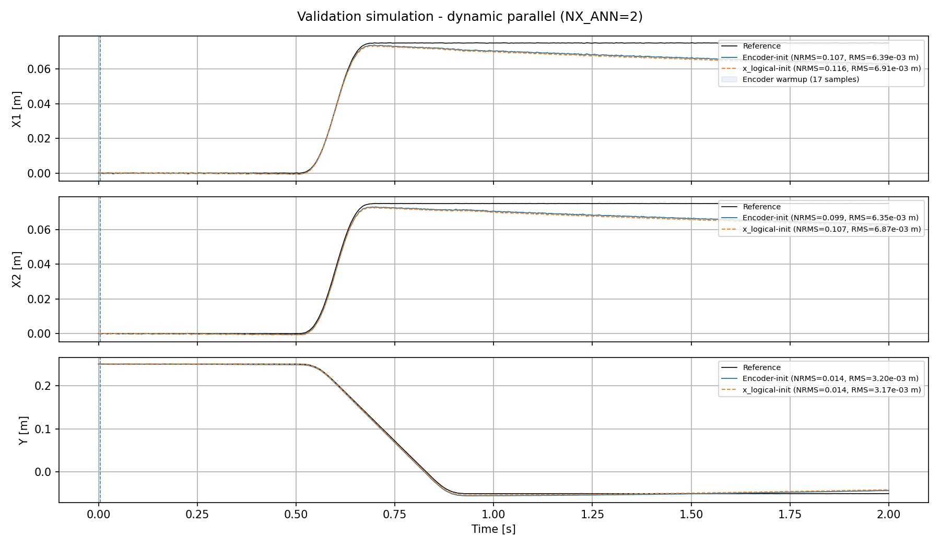

Slide 19
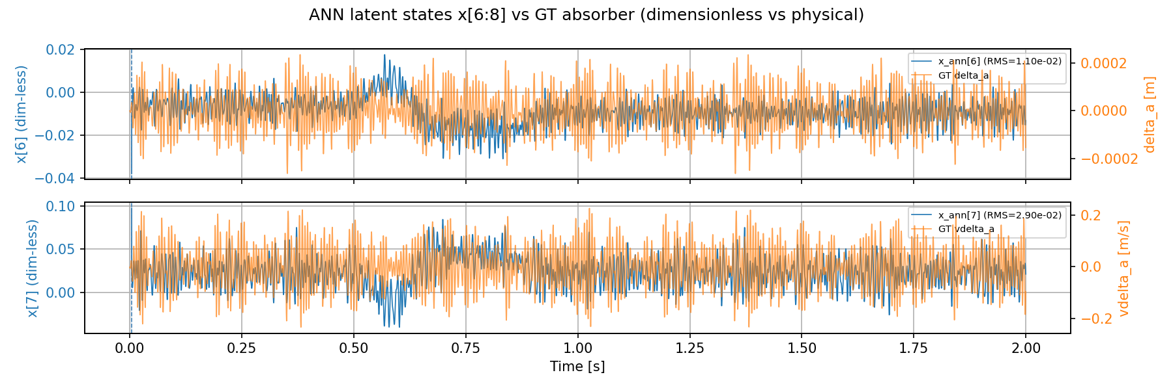

Slide 20
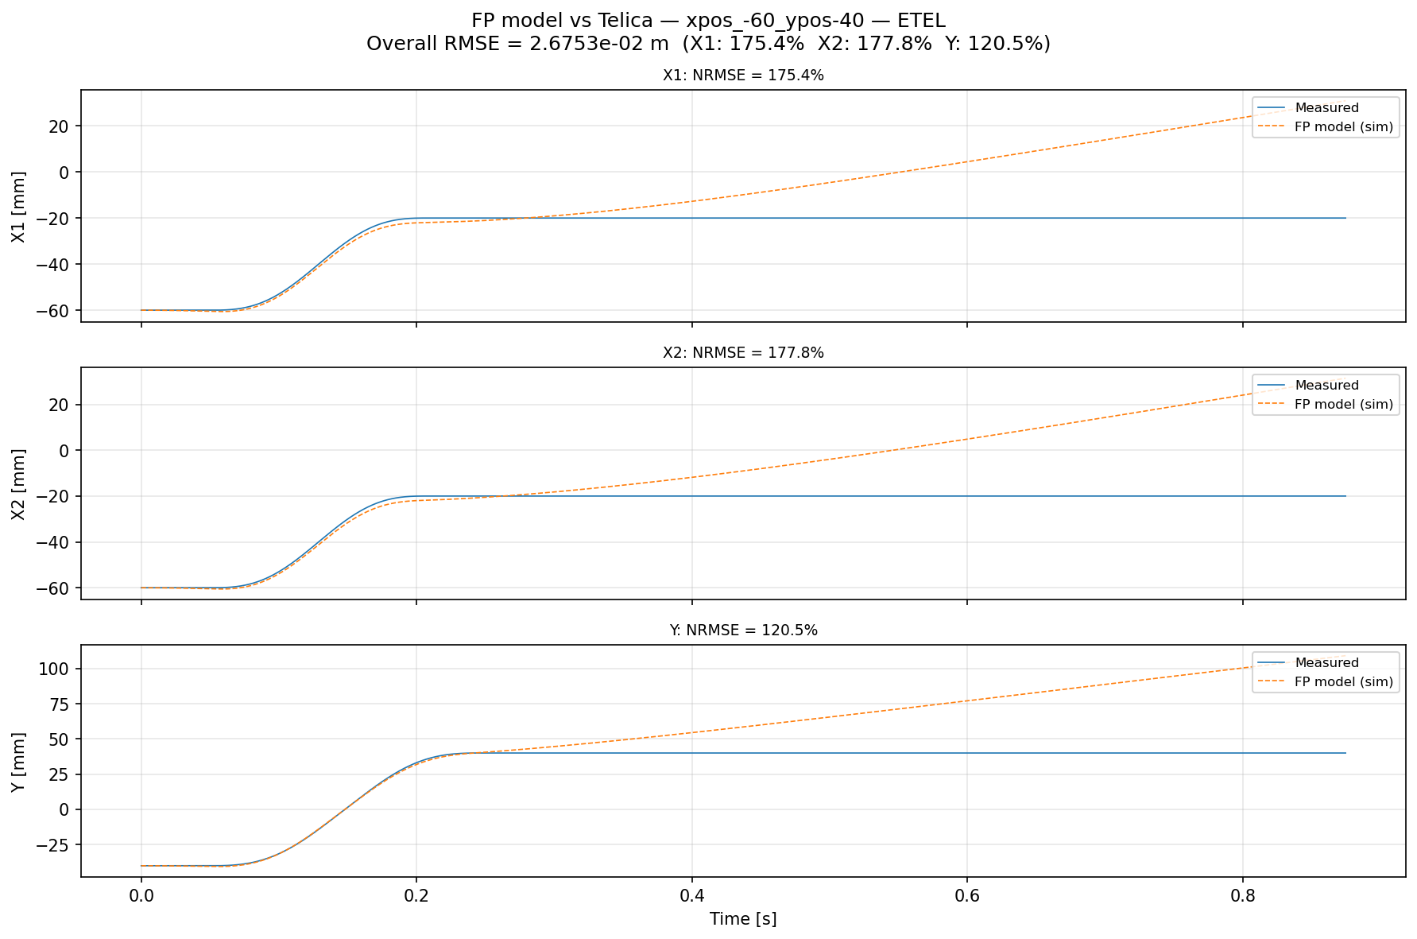
Real data verification
Previously drift off
  Open-loop issue
Solution:
  Re-run fitted model in closed-loop

Slide 21
Real data verification
Previously drift off
  Open-loop issue
Solution:
  Re-run fitted model in closed-loop
  Longer horizon

Slide 22
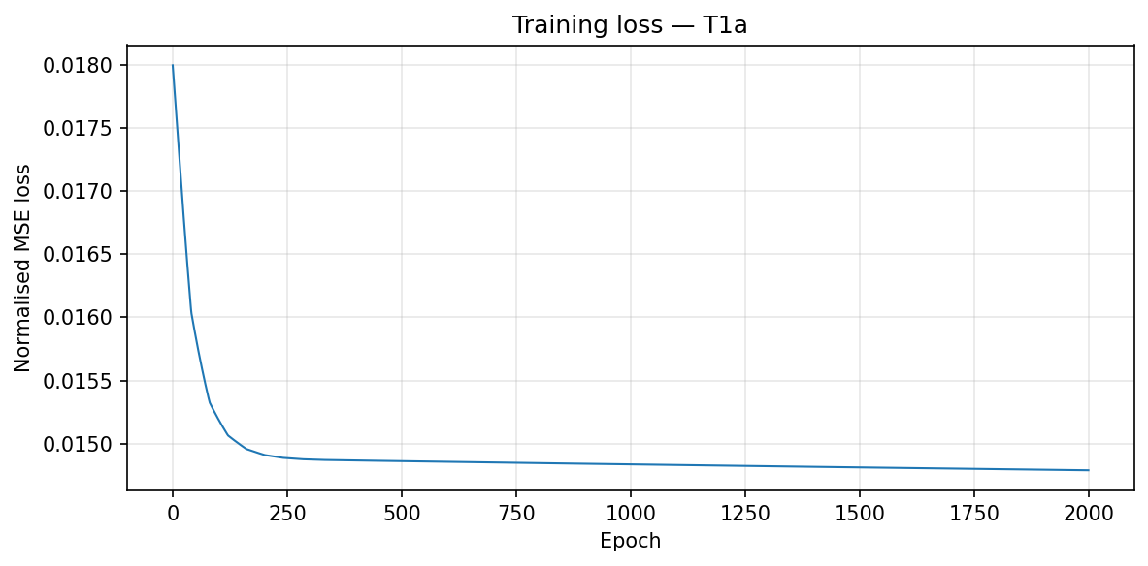
Training loss
Barely moved

Slide 23
Outline next week
First fix that I reach the noise floor for augmentation without joint estimation
  Then with joint estimation
Look into adding orthogonality
  First augmentation needs to be working
  But runs take a long time so before I see results prefer working in parallel

Slide 24
